Slide 1

Hospitalization Stays Prediction
Tom Hines & Karthik Radhakrishnan

Slide 2
Project Objectives
Objective 1
Produce a regression model to verify if the infection risk and associated factors are associated with patient’s length of stay even after accounting for other variables such as Age, Number of Nurses, etc.…
Objective 2
Fit 2 additional models ( one MLR model with added complexity and another non-Parametric model) to predict length of hospital stay and provide recommendation on which model would be the best to predict future patient’s hospital stays.

Slide 3
Data Description
Data set consists of 11 variables collected on each of 113 hospitals.
Breakdown:
8 Numerical explanatory variables
2 Categorical explanatory variables
1 Response variable
Variable Name | Description
Hospital ID | ID of the hospital
Length of Stay | Average length of stay (in days)
Age | Average age of patients (years)
Infection risk | Average estimated probability of hospital infection
Routine culturing ratio | Ratio of # of cultures performed to number of patients without symptoms of infection times 100
Routine chest X-ray ratio | Ratio of # of cultures performed to number of patients without symptoms of pneumonia time 100
Number of beds | Average number of beds
Medical School Affiliation | 1=Yes, 2=No
Region | Geographic region: 1=NE, 2=NC,3=S, 4=W
Average Daily census | Average number of patients in hospital per day
Number of nurses | Average number of full time nurses
Available facilities | Percent of 35 potential facilities and services that are provided by the hospital

Slide 4
Exploratory Data Analysis

Slide 5
Questions of Interest
What is the nature of relationship between explanatory variables and response variable?
1
Are there any multicollinearity between the explanatory variables?
2
correlation analysis between explanatory variables and response variable.
3
What is the impact of categorical variables on length of stay?
4

Slide 6
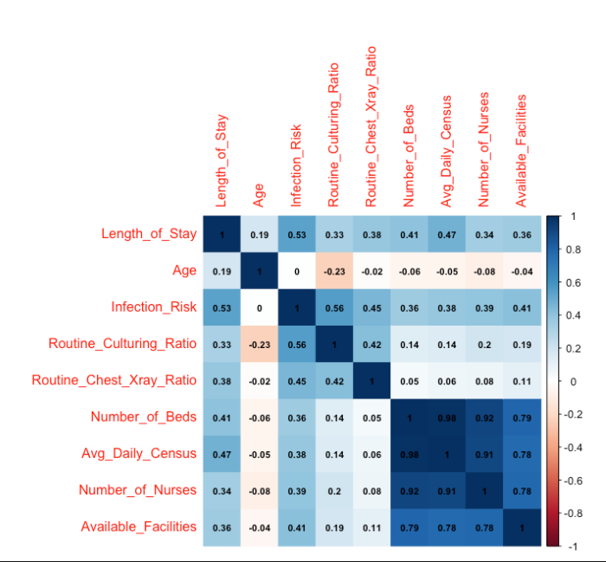
Correlation Analysis
Infection risk has moderate positive correlation with Length of Stay.
Number of beds and Number of nurses have high correlation with each other.
Number of beds and Average daily census have moderate positive correlation with Length of stay.

Slide 7
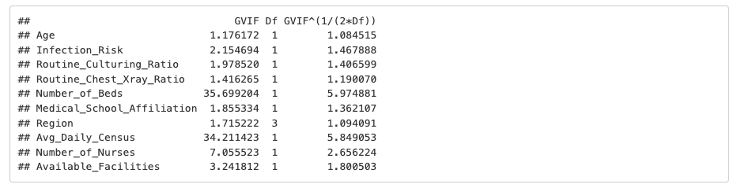
Multicollinearity
VIF is calculated from the simple multi linear regression model with all the predictor variables without any complexity.
Number_of_Beds (5.97) and Avg_Daily_Census (5.85) have the highest VIF values, suggesting potential
multicollinearity issues with these variables.

Slide 8
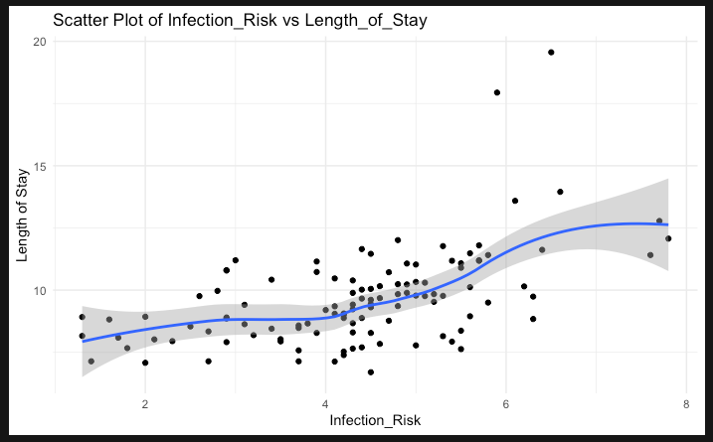
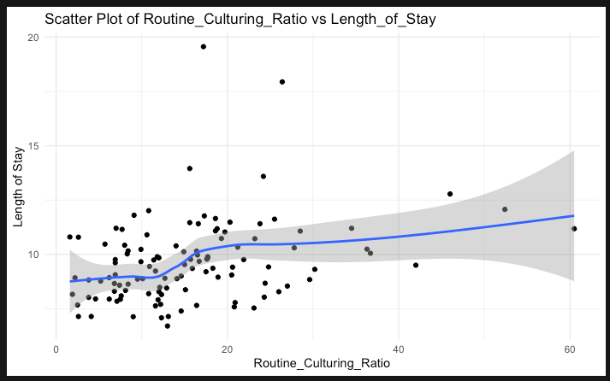
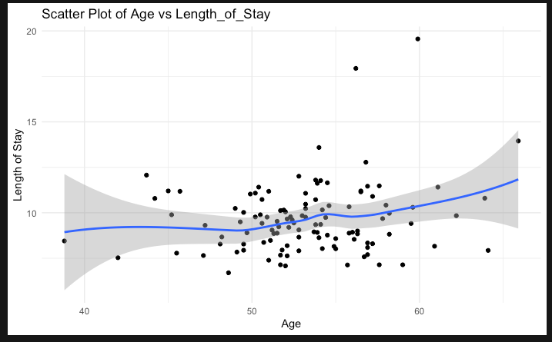
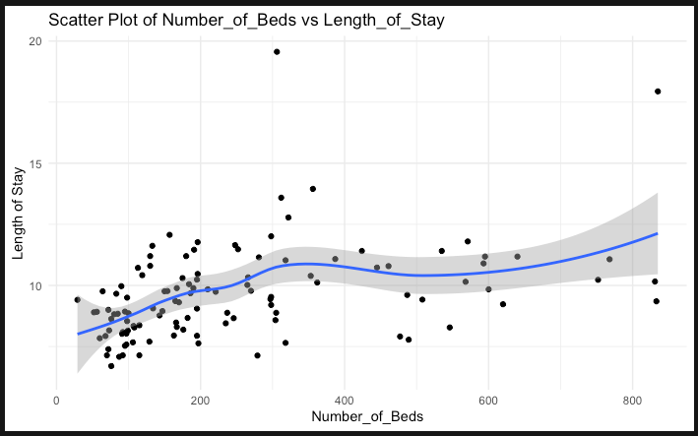
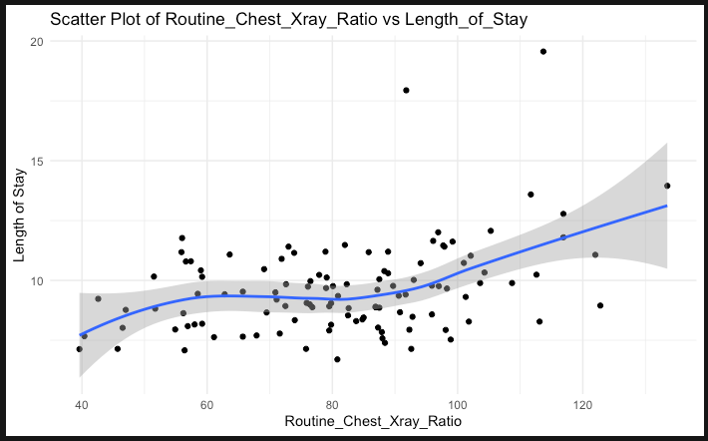
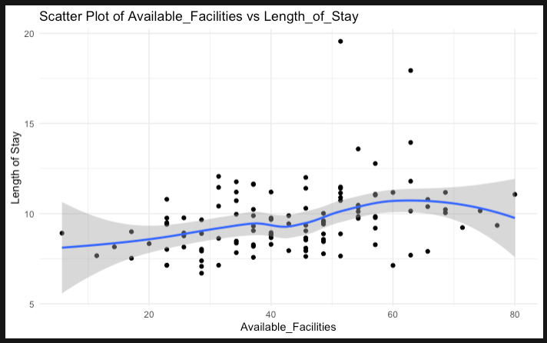
Relationship between numerical explanatory variables and response variable
None of the numerical explanatory variables have clear linear relationship with length of stay.
Infection Risk, Number of Beds and Routine Chest X ray variables have moderate linear positive trend with length of stay.
Age, Routine Culturing Ration and Available facilities have weak or unclear linear relationships with length of stay

Slide 9
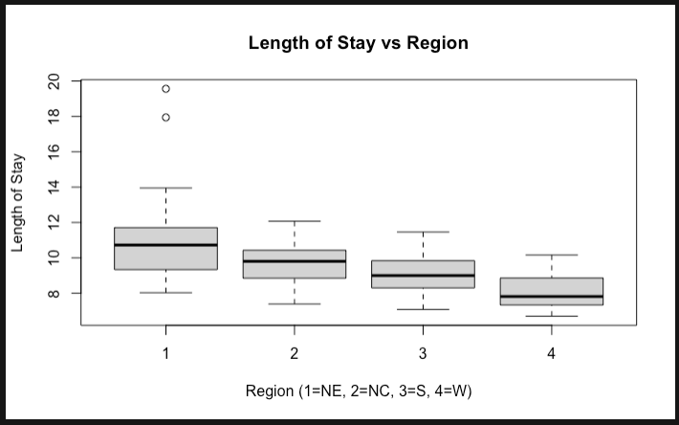
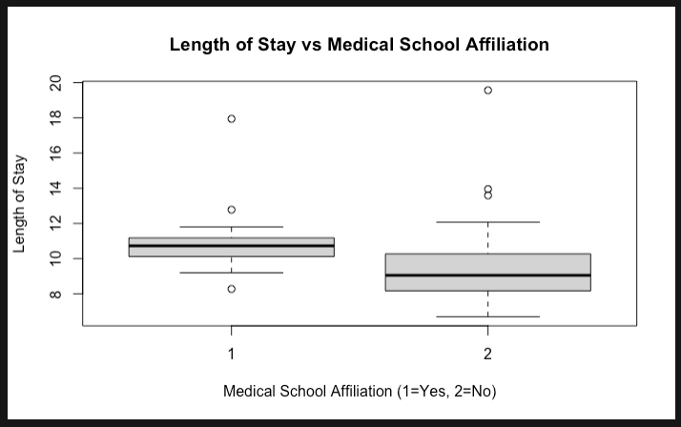
Impact of Categorical Variables
The Northeast region has longer hospital stays, whereas the West has shorter and less variable stays.
Medical school-affiliated hospitals have slightly longer, and more variable hospital stays, possibly due to differences in care practices often found in teaching hospitals.

Slide 10
Objective 1

Slide 11
Approach
Feature
Selection
Feature Selection using Lasso regression after Scaling.
Model Building
Build a MLR model with features selected by Lasso regression.
Assumption Validations
Check whether assumptions of MLR is met by the model built.
Apply
transformations (if needed)
Apply transformations if assumptions are not met.
Answer
Answer the primary question in Objective 1 with interpretation of regression coefficient along with confidence interval.

Slide 12
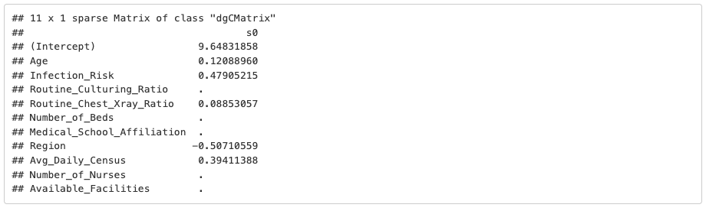
Feature Selection by Lasso Regression
Lasso regression is used for feature selection after scaling the variables.
Below are the variables selected.
Notes:
1. Steps – First simple random forest model, Addressed class imbalance, did hyper parameter tuning

Slide 13
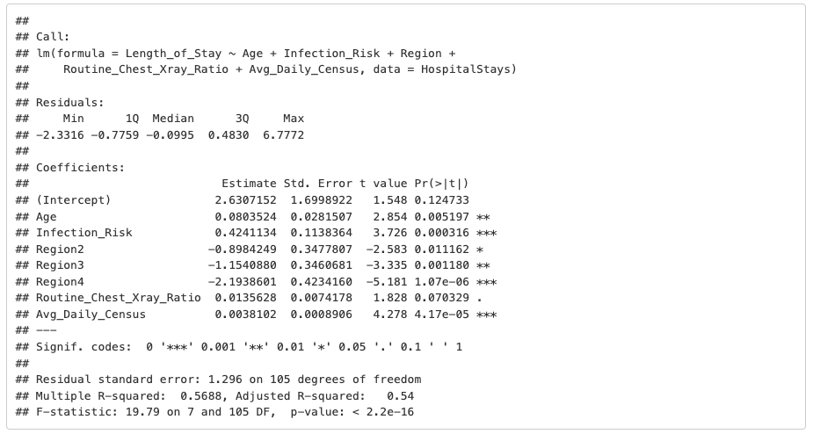
MLR Model
MLR model built using the features selected by Lasso.
Length_of_Stay ~ Age + Infection_Risk + Region + Routine_Chest_Xray_Ratio+ Avg_Daily_Census

Slide 14
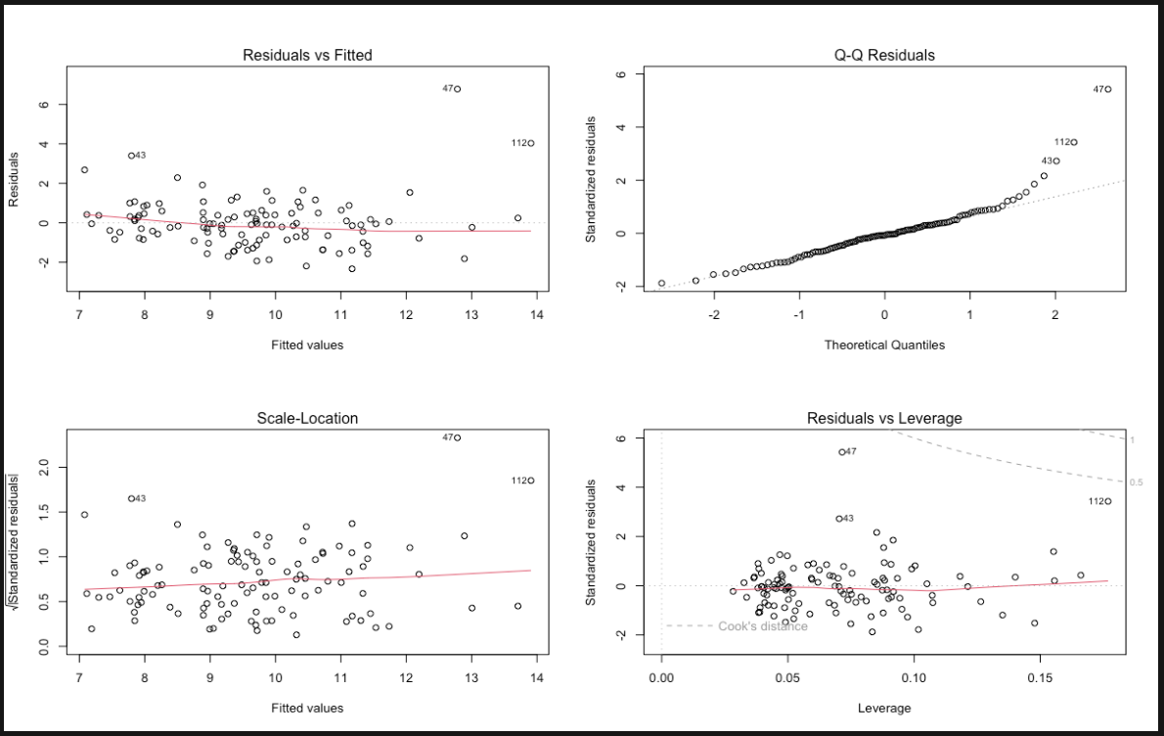
Assumptions Validation
Residual plots
Linearity: Generally satisfied, as there's no clear non-linear pattern in the residuals vs fitted plot.
Constant Variance: Mild violation, as the spread of residuals increases slightly with fitted values in the Scale-Location plot
Normality: As per the Q-Q plot, residuals are approximately normally distributed, with some potential outliers in the upper tail.
Independence: We assume independence of observations since there is no indication from data description to suggest this is violated.
Influential outliers: No outliers outside of cook’s distance lines.

Slide 15
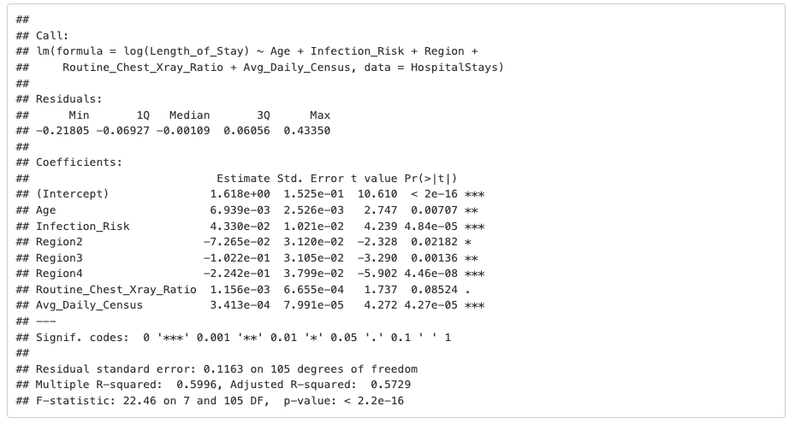
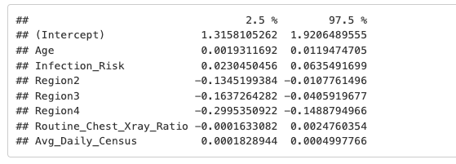
Applying Transformations
Applying log transformation of response variable since constant variance assumption is not met and building another model.
log(Length_of_Stay) ~ Age + Infection_Risk + Region + Routine_Chest_Xray_Ratio+ Avg_Daily_Census
Regression coefficients
Confidence Intervals

Slide 16
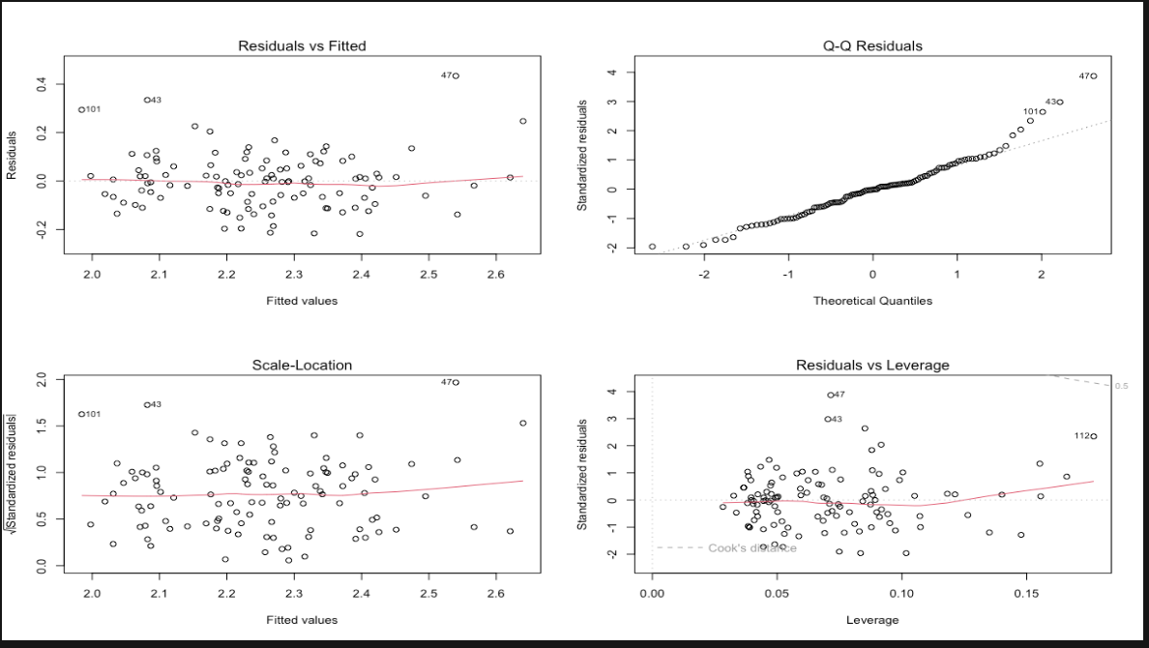
Assumptions Validation after Transformation
Residual plots
Linearity: Generally satisfied, as there's no clear non-linear pattern in the residuals vs fitted plot.
Constant Variance: Spread of residuals is more consistent across fitted values in Scale - location Plot, indicating that issue of heteroscedasticity has been reduced by log transformation.
Independence: We assume independence of observations since there is no indication from data description to suggest this is violated.
Influential outliers: No outliers outside of cook’s distance lines.
Normality: As per the Q-Q plot, residuals are approximately normally distributed, with some potential outliers in the upper tail.

Slide 17
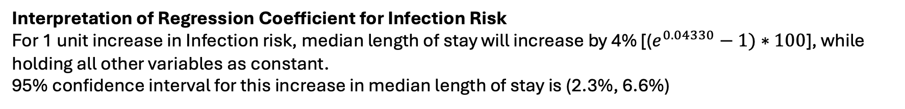
Analysis using the fitted model after transformation
log(Length_of_Stay) ~ Age + Infection_Risk + Region + Routine_Chest_Xray_Ratio+ Avg_Daily_Census
Regression coefficients
Confidence Intervals
As per this model, Infection risk is
associated with patient’s length of stay even after
accounting for other variables such as Age, Region,
Average Daily Census, etc.…
Interpretation of Regression Coefficient for Infection Risk
For 1 unit increase in Infection risk, median length of stay will increase by 4% [($e^{0.04330}−1)∗100$], while holding all other variables as constant.
95% confidence interval for this increase in median length of stay is (2.3%, 6.6%)

Slide 18
Objective 2

Slide 19
Approach
Model Building
Build another MLR model with additional complexity
Comparison of Models
Compare the 3 models (MLR without complexity, MLR with Complexity and Non-Parametric model) using an error metric
Recommendation
Recommend a best model that can be used to predict future patient hospital stays
Build a Non-Parametric Model

Slide 20
Model 1 – MLR without Complexity
Applying log transformation of response variable since constant variance assumption is not met and building MLR model without any complexity
MLR Model 1
log(Length_of_Stay) ~ Age + Infection_Risk + Region + Routine_Chest_Xray_Ratio+ Avg_Daily_Census
Regression coefficients
RMSE (Original Scale) = 1.118647
RMSE Interpretation: Predictions are off by 12% on average relative to actual values.
MAE (Original Scale) = 0.83
MAE Interpretation: The predicted hospital stays by the model are on average 17% smaller than the actual days.

Slide 21
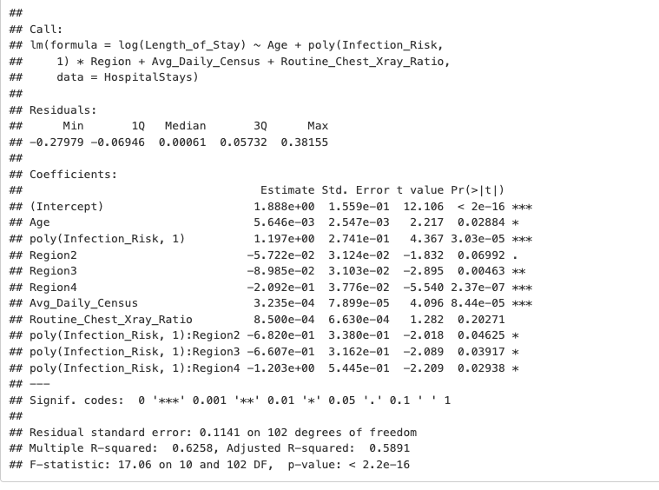
Model 2 – MLR with Complexity
Added a first-degree polynomial term for Infection_Risk & Interaction with Region
MLR Model 2
lm(log(Length_of_Stay) ~ Age + poly(Infection_Risk, 1) * Region + Avg_Daily_Census + Routine_Chest_Xray_Ratio
Regression coefficients
RMSE (Original Scale) = 1.11448
RMSE Interpretation: Predictions are off by 11% on average relative to actual values.
MAE (Original Scale) = 0.82
MAE Interpretation: The predicted hospital stays by the model are on average 18% smaller than the actual days.

Slide 22
Model 3 – Non-Parametric Model

Slide 23
Comparison of Models & Recommendation

